Slide 1
CONTENTS
Problem Statement
Abstract/Introduction
Objective
Existing System
Disadvantages of Existing System
Literature Review
Proposed System
Advantages of Proposed System
Block/Architecture Diagram
Modules Description
Hardware Requirements
Software Requirements
Application
References

Slide 2
EXISTING SYSTEM
In the existing system, they developed an explainable deep learning system called VinDr-CXR that can classify a CXR scan into multiple thoracic diseases and, at the same time, localize most types of critical findings on the image.
VinDr-CXR was trained on 51,485 CXR scans with radiologist-provided bounding box annotations.
A prospective study was also conducted to measure the clinical impact of the VinDr-CXR in assisting six experienced radiologists.

Slide 3
DISADVANTAGES OF EXISTING SYSTEM
In the existing system, there is no clear evidence that the DLS helps improve the sensitivity or specificity of the radiologist in CXR interpretation.
Further research is needed to validate the model prospectively and determine its utility in clinical settings.

Slide 4
PROPOSED SYSTEM
In this project, we will be using Deep Learning algorithm and machine learning algorithm such as Random Forest Classifier and yolov7 model to detect and classification of lung diseases at an early stage.
The datasets will be collected from VINDR-CXR dataset.
Dataset Augmentation is used to increase the amount of datasets.
After augmentation, Image Resizing technique is used for dataset preprocessing.
Feature extraction methods such as InceptionV3, Xception, InceptionResNetV2 and NASNetLarge under transfer learning are used to extract the features.
Then, it will be trained using machine learning algorithm such as Random Forest Classifier and deep learning algorithm such as yolov7 model to effectively determine the lung disease.
When an input image is given for prediction process, it can easily predict and classifies the lung disease such as Atelectasis, Emphysema, Lung Opacity, Lung cavity etc.
A web application is developed for providing input image for detecting and displaying output results.
Thus, this project helps in identifying and classifying the lung diseases from chest xrays in a more efficient way, thus saving the life of the patient at the earliest.

Slide 5
ARCHITECTURE DIAGRAM

Slide 6
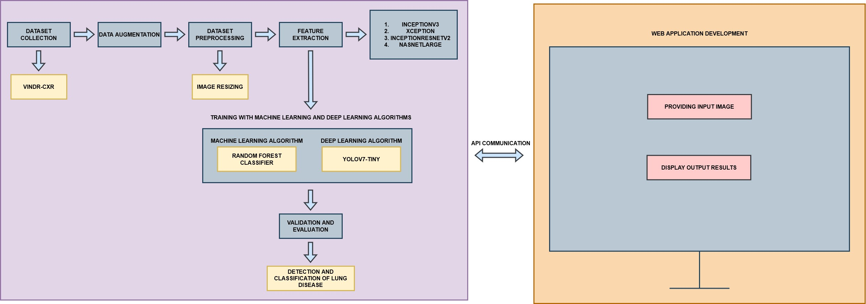

Slide 7
MODULES DESCRIPTION
Dataset Collection
Data Augmentation
Dataset Preprocessing
Feature Extraction
Training using Machine Learning and Deep Learning algorithms
Validation and Evaluation
Detection and Classification of Lung Disease
Web Application Development

Slide 8
DATASET COLLECTION
A dataset contains a lot of separate pieces of data but can be used to train an algorithm with the goal of finding predictable patterns inside the whole dataset.
The first thing to do is collecting dataset.
High quality is the essential thing to take into consideration when collecting a dataset.
For this project dataset is collected from VINDR-CXR dataset.
Then the dataset is divided into two parts,
Training dataset – used to train an algorithm to understand and learn.
Testing dataset – used to evaluate how well an algorithm was trained.

Slide 9
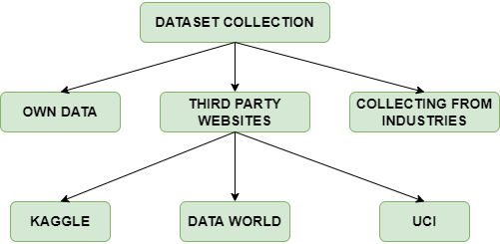
DATASET COLLECTION DFD

Slide 10
DATA AUGMENTATION
The performance of deep learning neural networks often improves with the amount of data available.
Data augmentation is a technique to artificially create new training data from existing training data. This is done by applying domain-specific techniques to examples from the training data that create new and different training examples.
Image data augmentation is perhaps the most well-known type of data augmentation and involves creating transformed versions of images in the training dataset that belong to the same class as the original image.

Slide 11
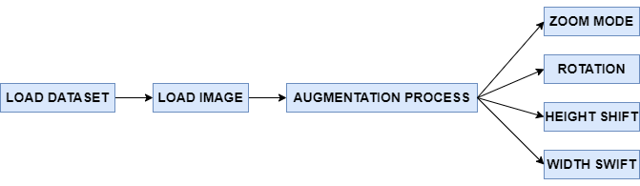
DATA AUGMENTATION DFD

Slide 12
DATASET PREPROCESSING
A real-world data generally contains noises, missing values, and maybe in an unusable format which cannot be directly used for deep learning models.
Data preprocessing is required tasks for cleaning the data and making it suitable for a deep learning model which also increases the accuracy and efficiency of a deep learning model.
In this project, Image Resizing technique is used for dataset preprocessing.
In deep learning, image resizing refers to the process of changing the size of an image while preserving its aspect ratio.
Image resizing is a common pre-processing step in deep learning tasks that involve image data, such as object detection, image classification, and segmentation.

Slide 13
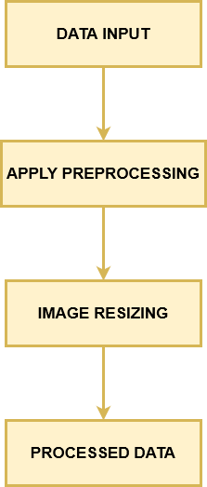
DATASET PREPROCESSING DFD

Slide 14
FEATURE EXTRACTION
Feature extraction methods such as InceptionV3, Xception, InceptionResNetV2 and NASNetLarge under transfer learning are used to extract the features.
Transfer learning (TL) is a technique in machine learning (ML) in which knowledge learned from a task is re-used in order to boost performance on a related task.
For example, for image classification, knowledge gained while learning to recognize cars could be applied when trying to recognize trucks.
In transfer learning, a machine exploits the knowledge gained from a previous task to improve generalization about another.
Transfer learning has applications in numerous deep learning projects, such as computer vision tasks like object detection or natural language processing tasks like sentiment analysis.

Slide 15
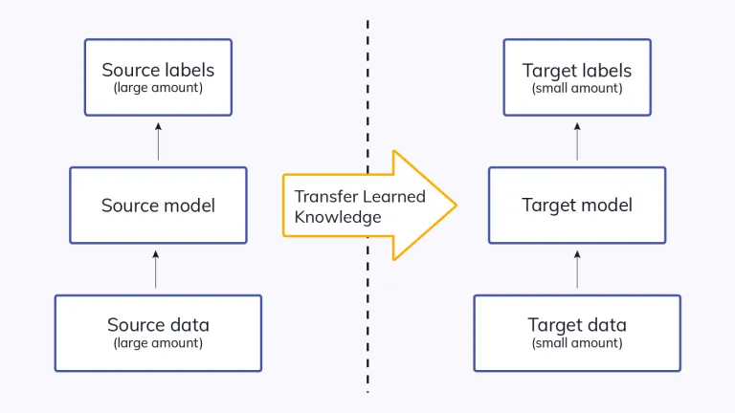
FEATURE EXTRACTION DFD

Slide 16
TRAINING USING MACHINE LEARNING AND DEEP LEARNING ALGORITHMS
After feature extraction, it will be trained using machine learning algorithm such as Random Forest Classifier and deep learning algorithm such as yolov7 model to effectively determine the lung disease.

Slide 17
RANDOM FOREST CLASSIFIER
Random forest is a commonly-used machine learning algorithm trademarked by Leo Breiman and Adele Cutler, which combines the output of multiple decision trees to reach a single result.
Its ease of use and flexibility have fueled its adoption, as it handles both classification and regression problems.
Random forest algorithms have three main hyperparameters, which need to be set before training.
Classification in random forests employs an ensemble methodology to attain the outcome. The training data is fed to train various decision trees. This dataset consists of observations and features that will be selected randomly during the splitting of nodes.

Slide 18
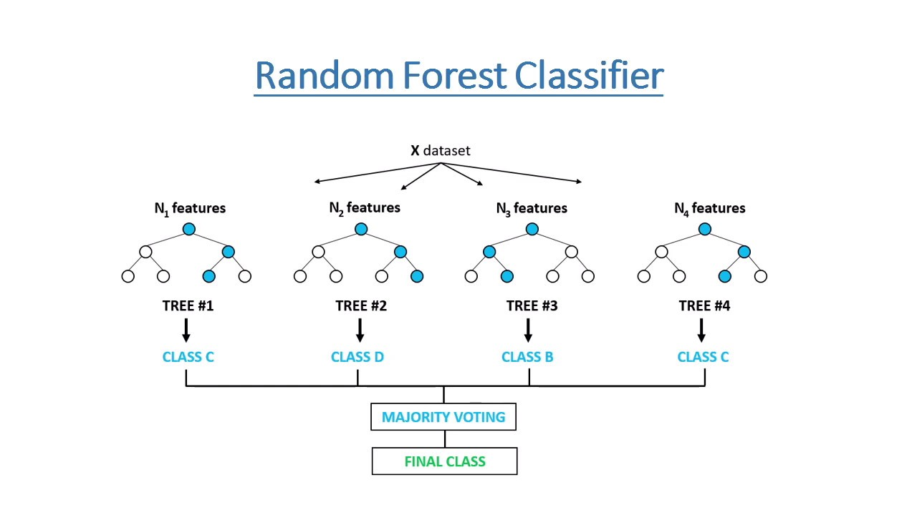
RANDOM FOREST CLASSIFIER

Slide 19
YOLOV7-TINY
The YOLOv7 algorithm is making big waves in the computer vision and machine learning communities.
YOLOv7 is a basic model optimized for edge GPU.
This model is important for distributed real-world computer vision applications.
Compared to the other versions, the edge-optimized YOLOv7 uses leaky ReLU as the activation function, while other models use SiLU as the activation function.

Slide 20
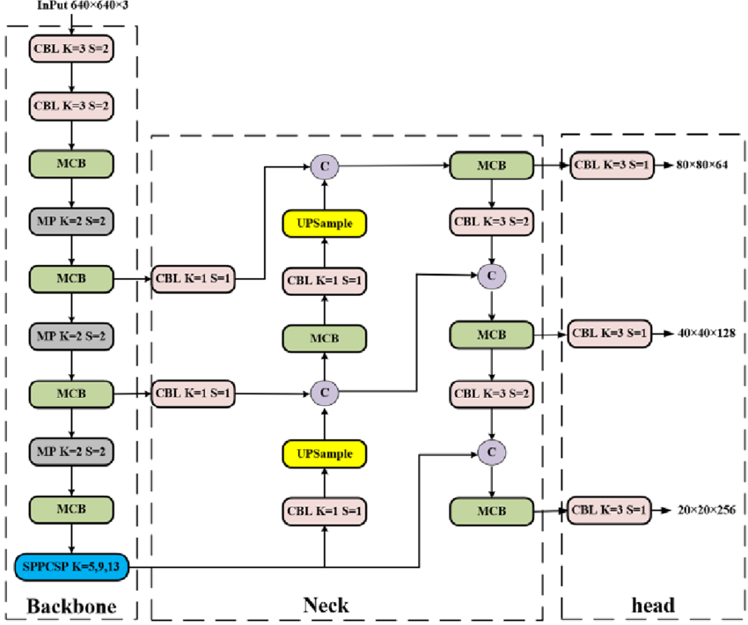
YOLOV7

Slide 21
VALIDATION AND EVALUATION
After training with machine learning and deep learning algorithms, it will validate and evaluate the datasets.
Validation in machine learning or deep learning is like a authorization or authentication of the prediction done by a trained model.
While on the other hand, evaluation in machine learning or deep learning refers to assessment or test of entire machine or deep learning model and its performance in various circumstances.
It involves assessment of machine learning or deep learning model training process and how accurate is the predictions given in different situations.

Slide 22
DETECTION AND CLASSIFICATION OF LUNG DISEASE
After validation and evaluation, when an input image is given for prediction process, it can easily predict and classifies the lung disease such as Atelectasis, Emphysema, Lung Opacity, Lung cavity etc.
Thus, this project helps in identifying and classifying the lung cancer in a more efficient way, thus saving the life of the patient at the earliest.

Slide 23
WEB APPLICATION DEVELOPMENT
A web application using a javascript framework, reactJS will be developed in which an input scanned image will give the output of the type of thyroid disease saving a lot of time and money invested by the patients.
React is a library for building composable user interfaces. It encourages the creation of reusable UI components, which present data that changes over time.
React abstracts away the DOM from you, offering a simpler programming model and better performance.

Slide 24
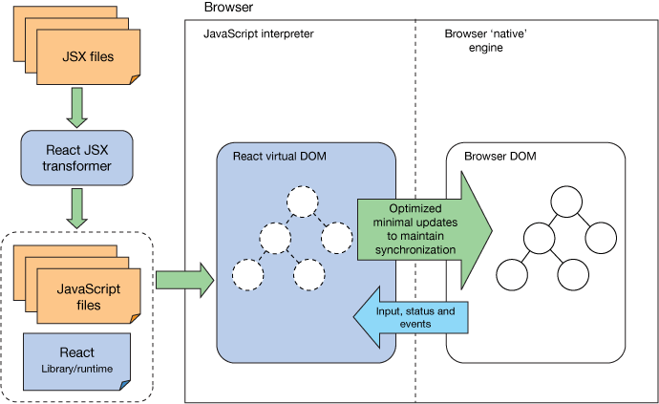
WEB APPLICATION DEVELOPMENT

Slide 25
OUTPUTS OBTAINED

Slide 26
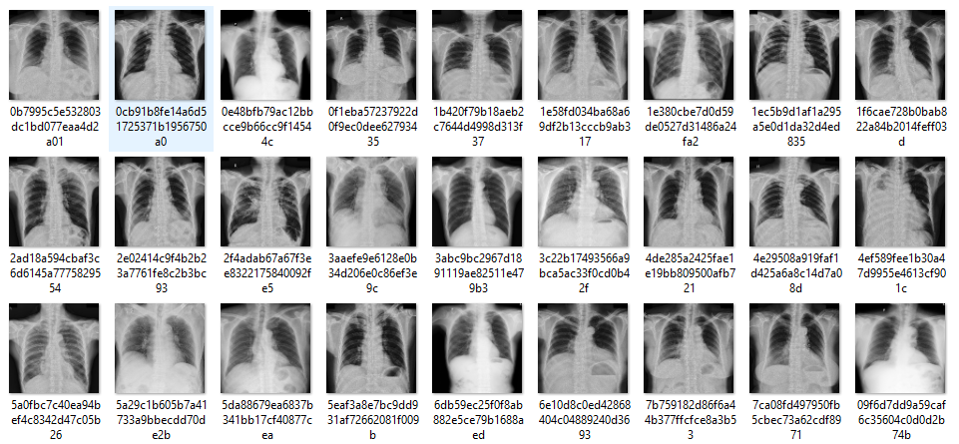
DATASET COLLECTION

Slide 27
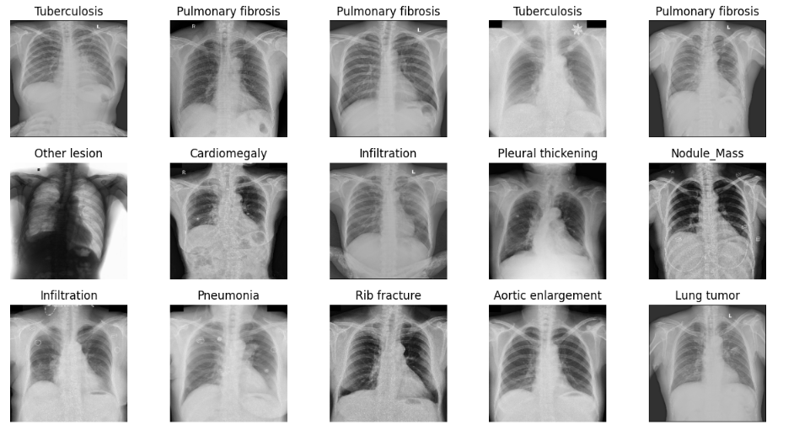
DATASET VISUALIZATION

Slide 28
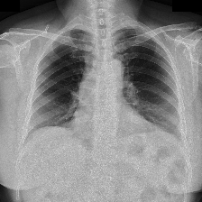
DATASET PREPROCESSING (SIMPLE PREPROCESSING)
INPUT
Random Size
OUTPUT
224x 224preprocessed

Slide 29
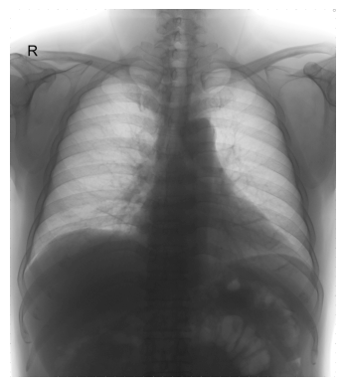
DATASET AUGMENTATION INPUT

Slide 30
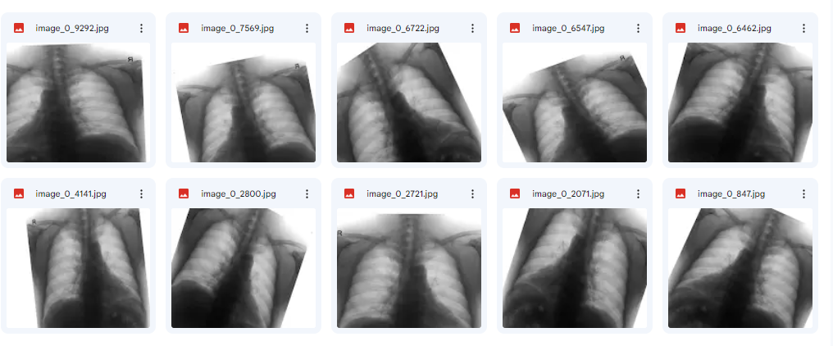
DATASET AUGMENTATION OUTPUT

Slide 31
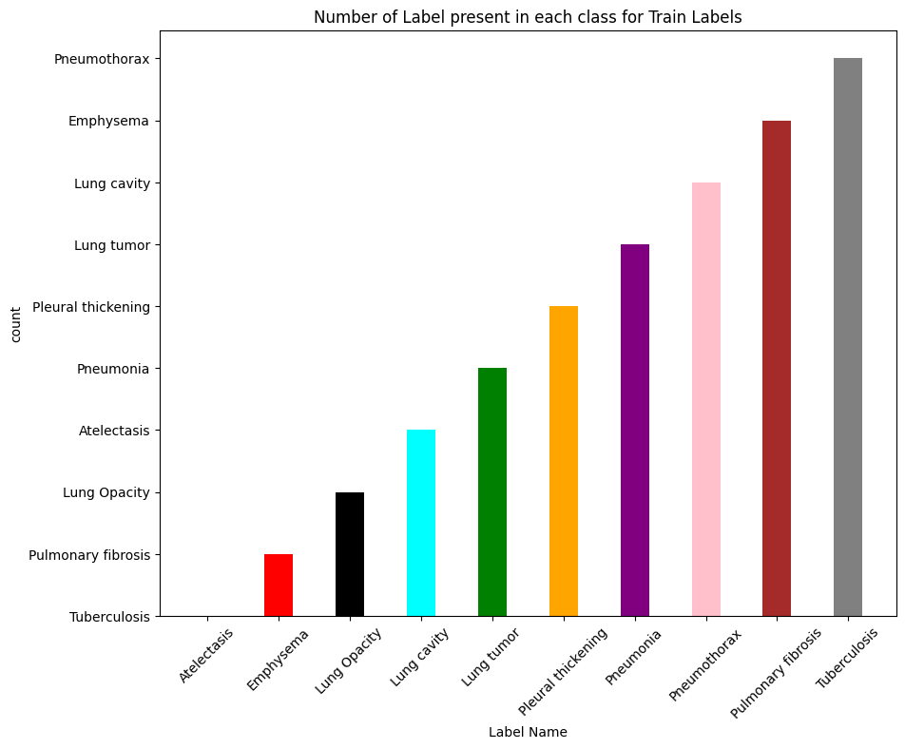
CLASS DISTRIBUTION USING BAR PLOT

Slide 32
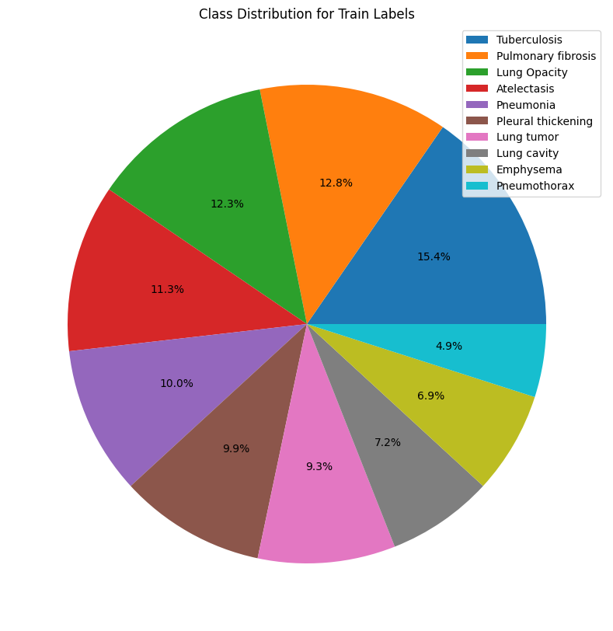
CLASS DISTRIBUTION IN PERCENTAGE USING PIE CHART

Slide 33
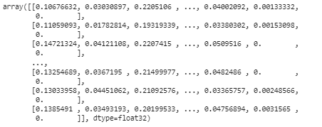
FEATURE EXTRACTION

Slide 34
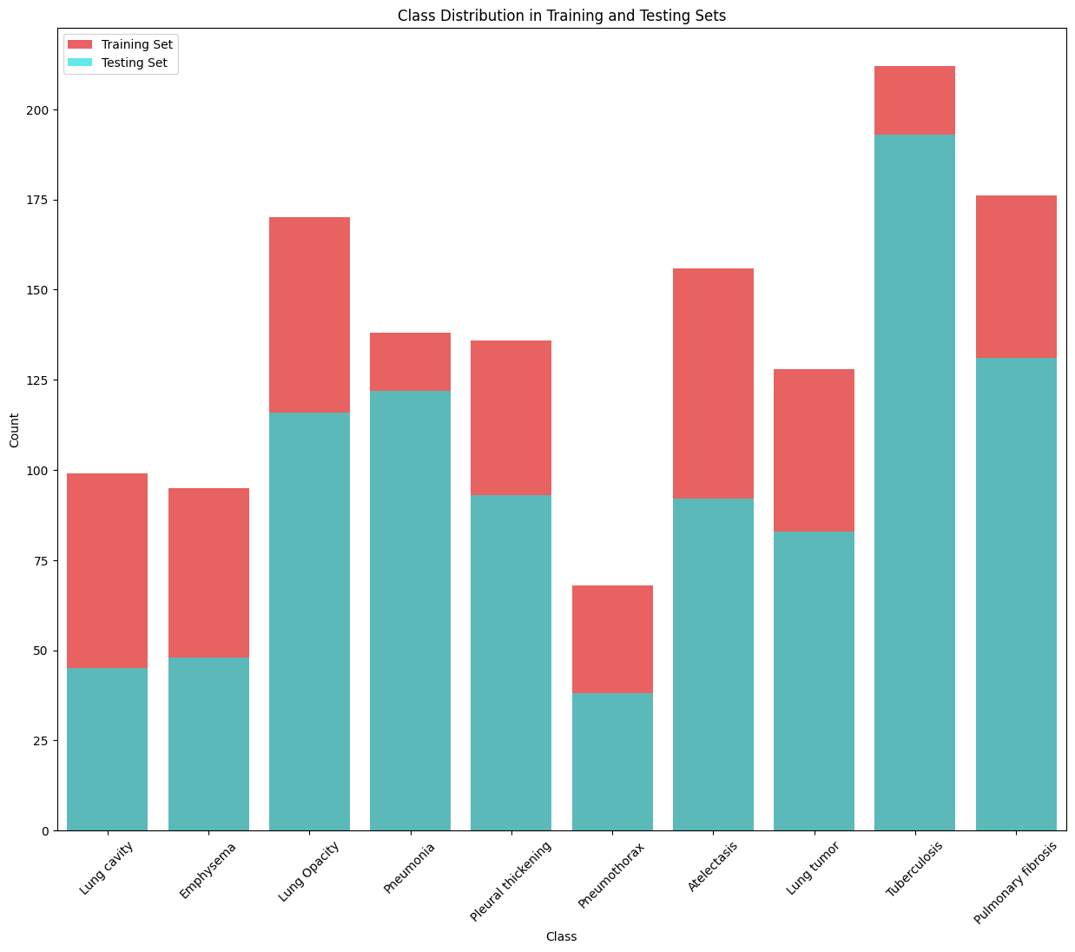
NO OF DATA PRESENTS IN TRAINING AND TESTING SET

Slide 35
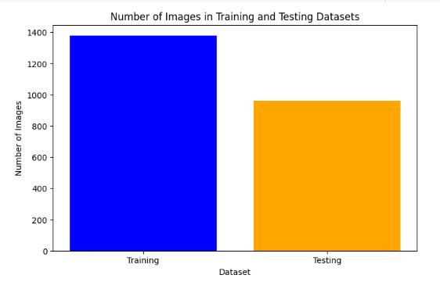
NO OF DATA IN TRAINING AND TESTING SET

Slide 36
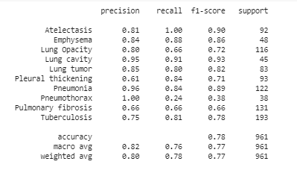
CLASSIFICATION REPORT

Slide 37
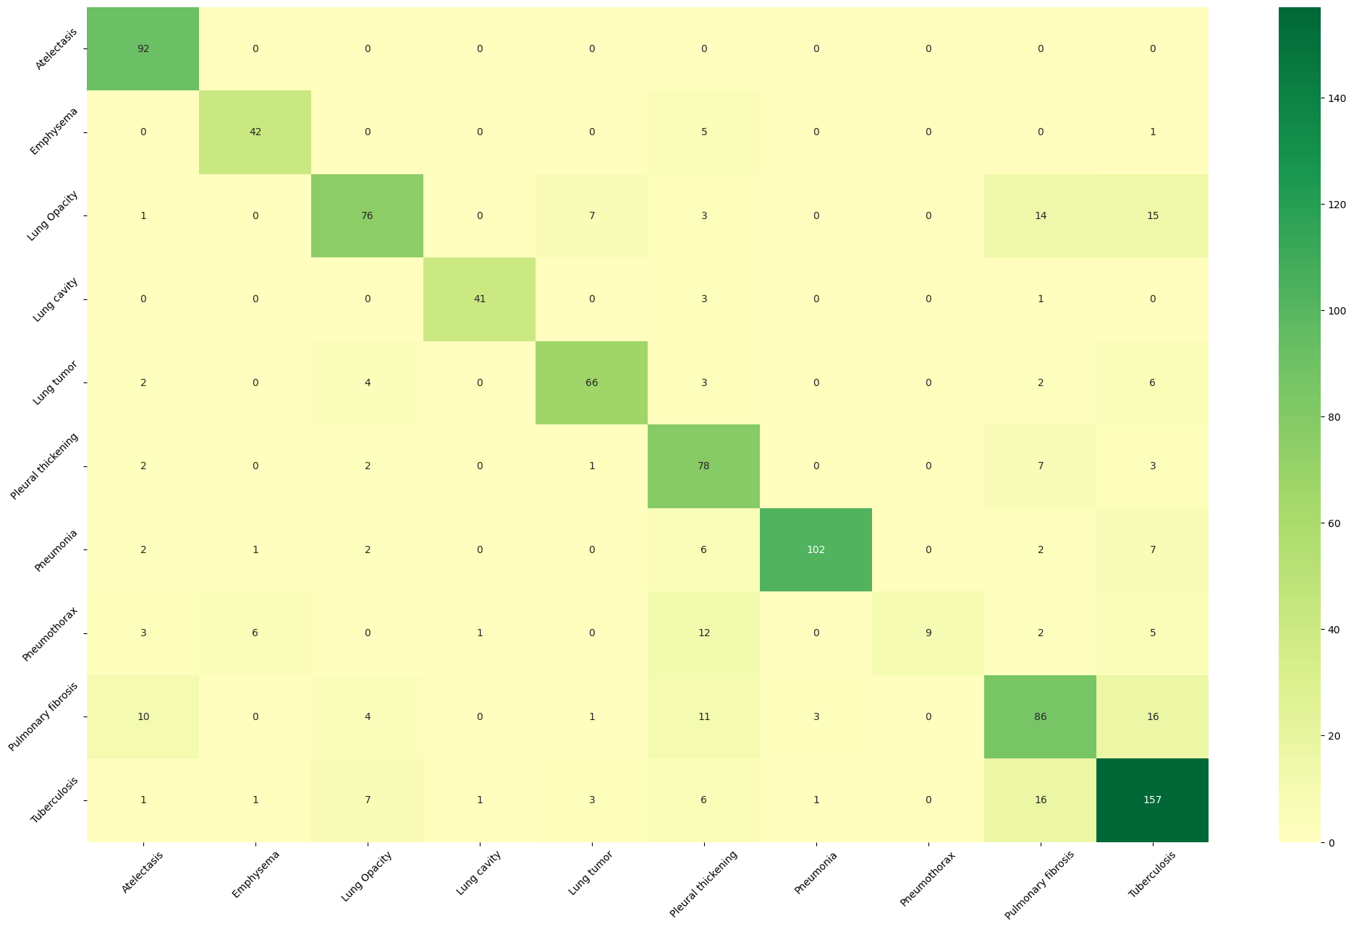
CONFUSION MATRIX

Slide 38
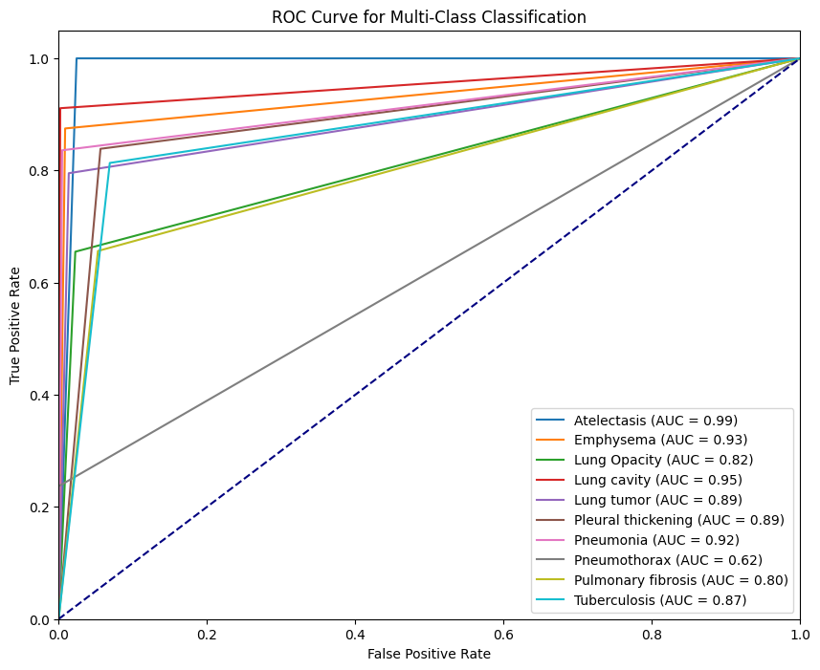
ROC CURVE

Slide 39
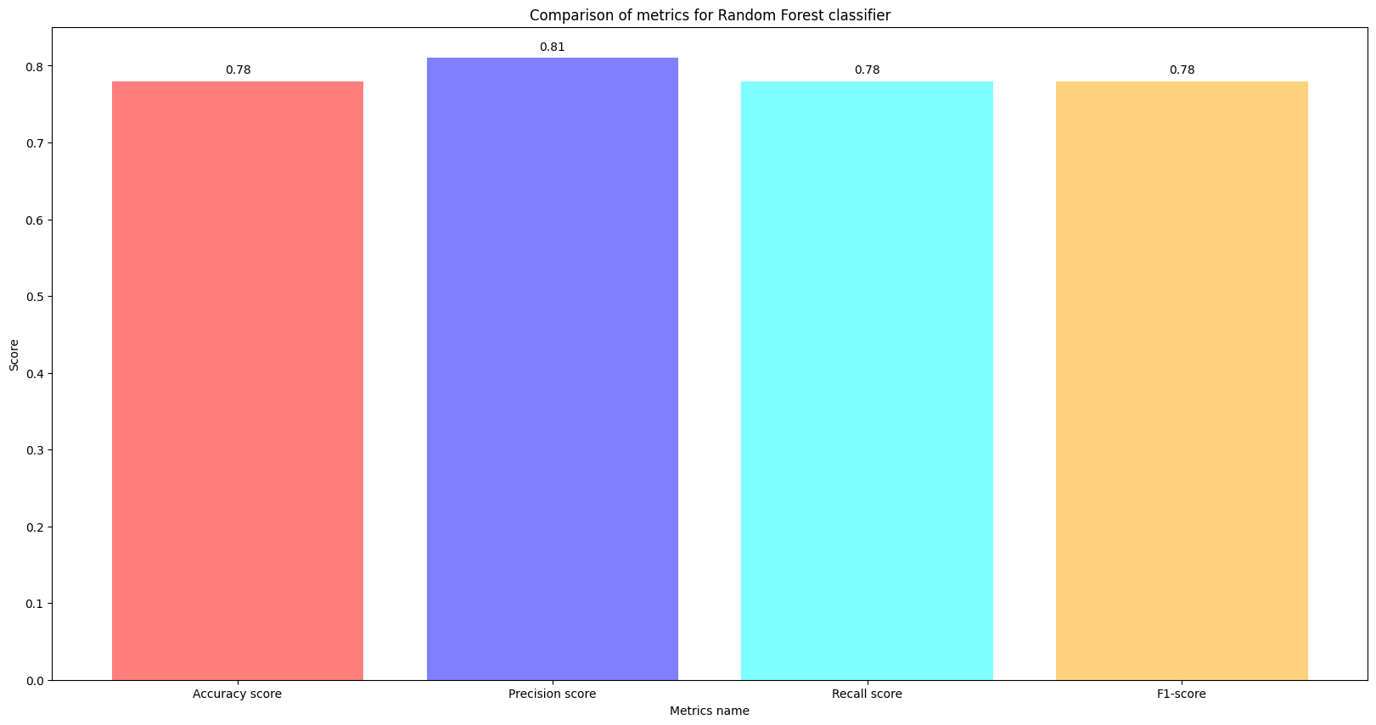
PERFORMANCE METRICS COMPARISON

Slide 40
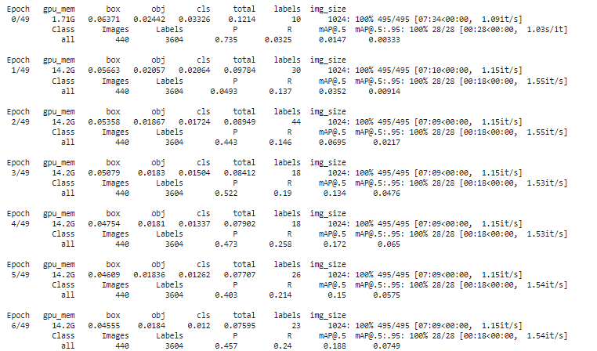
TRAINING RESULT OF YOLOV7 ALGORITHM

Slide 41
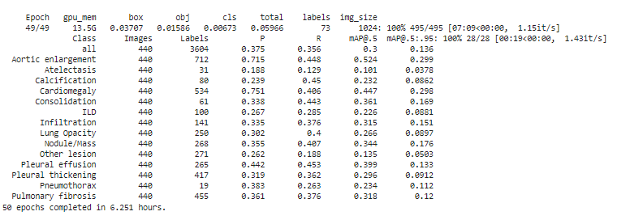
PERFORMANCE METRICS OF YOLOV7 ALGORITHM

Slide 42
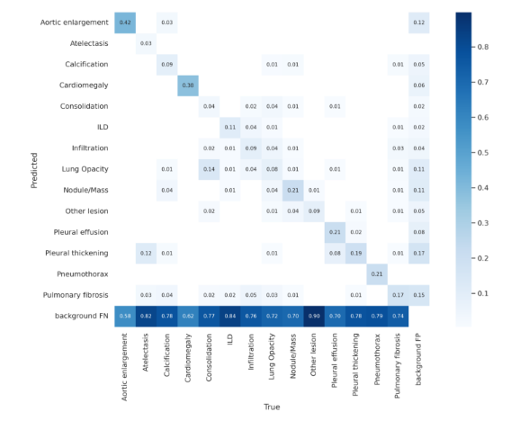
CONFUSION MATRIX

Slide 43
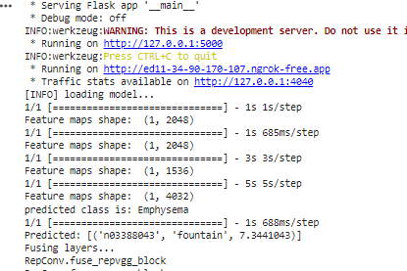
BACKEND INTEGRATE WITH FRONTEND USING FLASK FRAMEWORK AND
NGROK

Slide 44
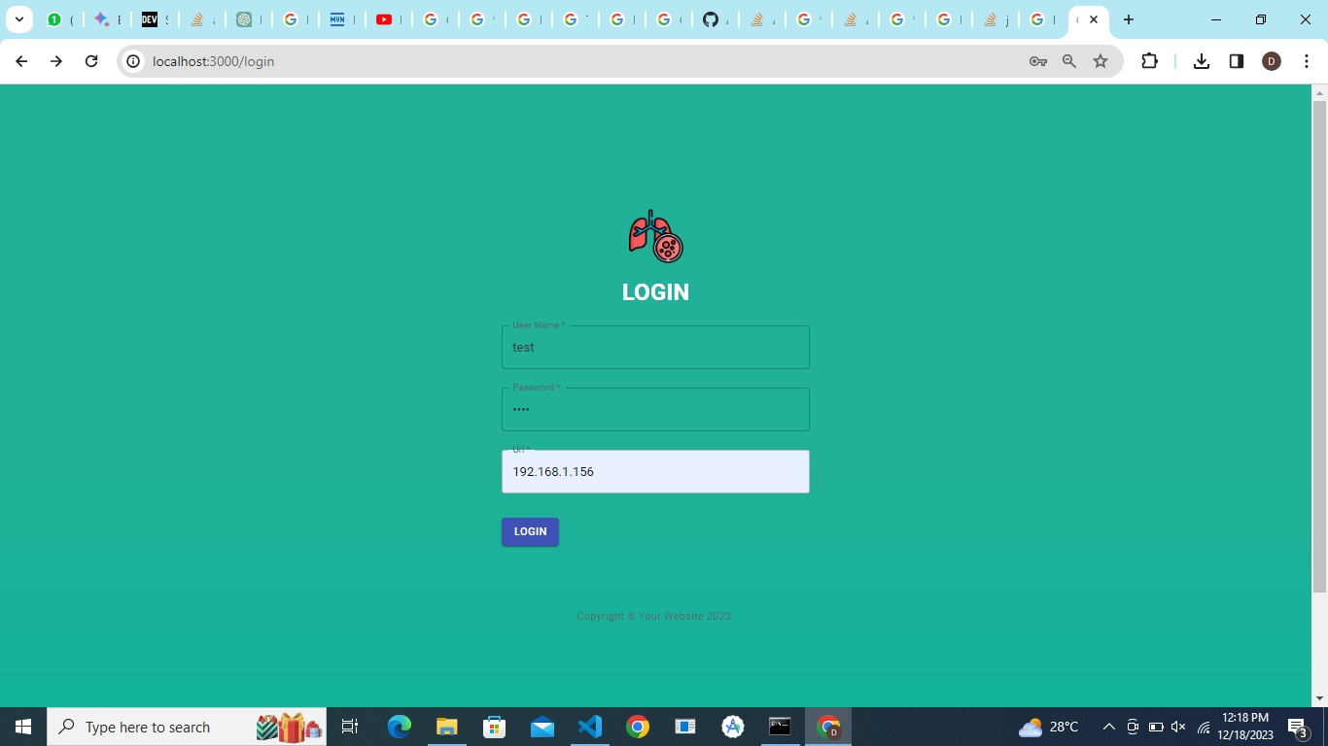
WEB APPLICATION LOGIN PAGE

Slide 45
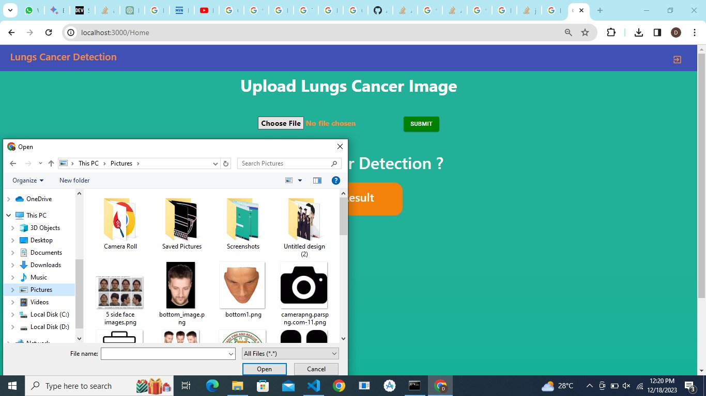
UPLOADING IMAGE

Slide 46
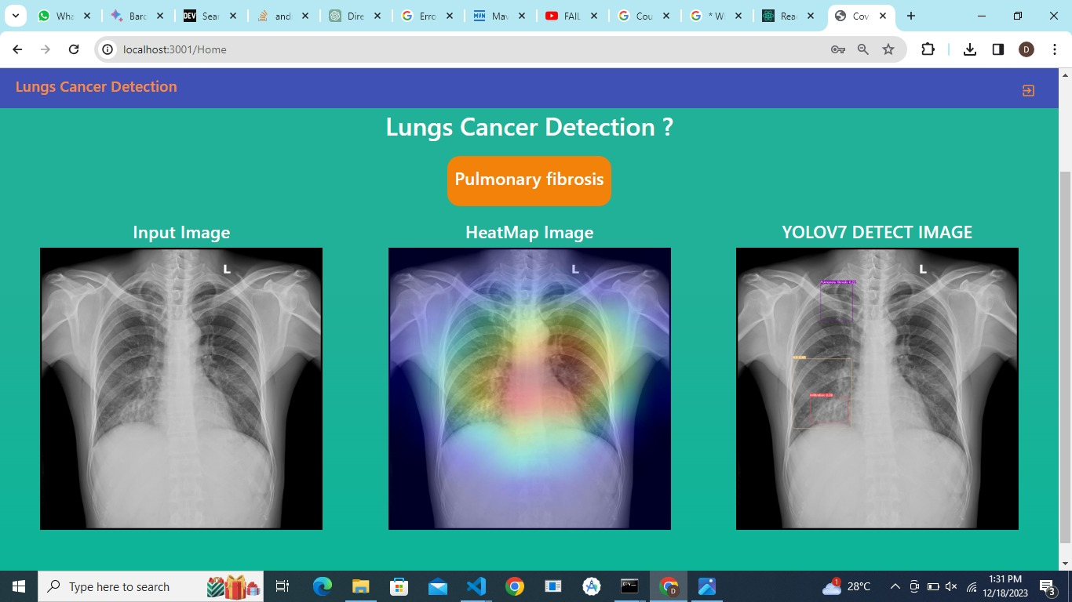
PREDICTION PROCESS

Slide 47
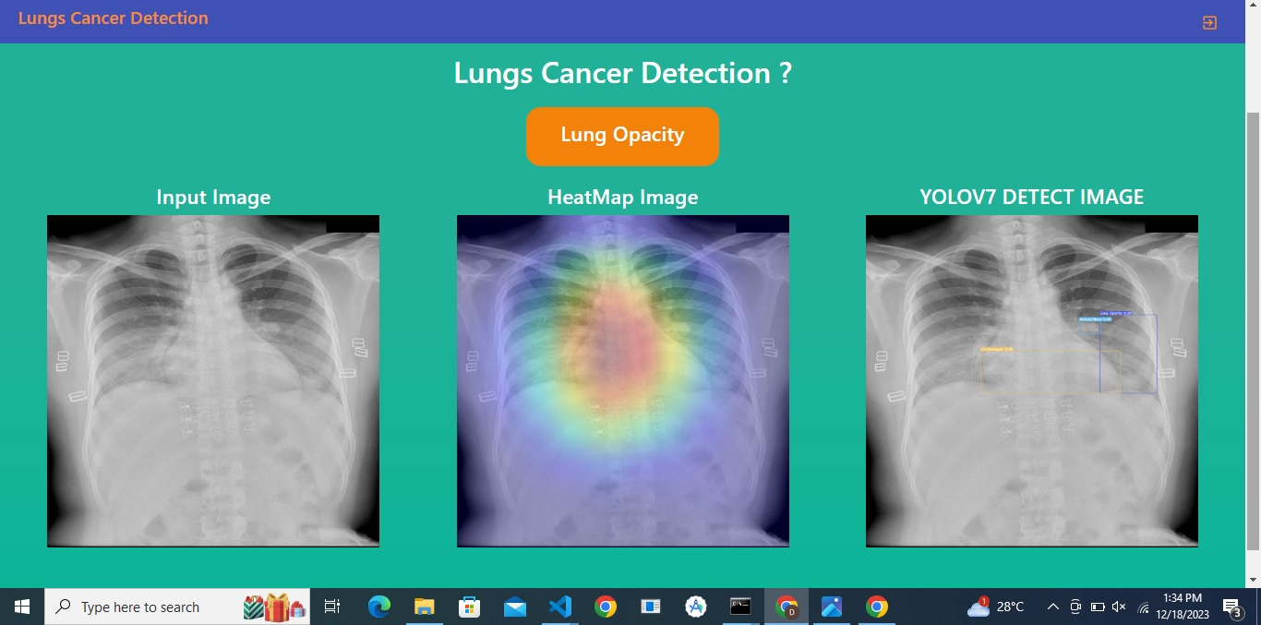
PREDICTED RESULT

Slide 48
HARWARE REQUIREMENTS
PC
RAM : 8 GB
Processor : i5
Hard disk : 1 TB

Slide 49
SOFTWARE REQUIREMENTS
GOOGLE COLAB
PYTHON
VISUAL STUDIO

Slide 50
APPLICATIONS
Used in hospitals
Used in laboratories
Used in day care centers
Used for test centers

